Slide 1
Functional/ Restorative Neurosurgery
Dr R Ramnarayan
Consultant Functional Neurosurgeon
Chennai, India.

Slide 2
What is Restorative neurosurgery?
Neurosurgery is that branch of medicine which deals with the surgical treatment of diseases of the brain, spinal cord and the nerves.
It is subdivided into many subspecialties like vascular neurosurgery, paediatric neurosurgery, spinal neurosurgery etc.
Restorative or Functional neurosurgery is that subspecialisation which deals with the surgical treatment of functional disorders of the brain. The brain is different from other organs in that the structure and function of the brain need not always go together.

Slide 3
What is Restorative neurosurgery?
1. Deep brain stimulation (DBS) for:
a) Movement disorders Parkinsonism, dystonias, essential tremor.
b) Some psychiatric problems like depression, OCD, etc.
c) Intractable alcoholism
d) Chronic pain especially the central post stroke pain.
e) Intractable epilepsy
f) Intractable obesity
g) some types of autism (aggressive types with self harm).
h) cases of schizophrenia.
DBS involves inserting electrodes into various parts of the brain depending on the pathology and stimulating it to get adequate relief.

Slide 4
What is Restorative neurosurgery?
2. Intrathecal pumps:
A). Intrathecal morphine (ITM) pumps are very useful in:
a) cancer pains
b) Failed back surgery syndromes.
c) Other types of noxious pain.
B) Intrathecal baclofen (ITB) pumps are good in
a) All types of spasticity as in
cerebral palsy
multiple sclerosis
Post stroke spastic hemiplegia
traumatic spastic paraplegics etc.
b) Patients in persistent vegetative state.
c) Cases of spino-cerebellar degeneration/ cerebellar type of MS

Slide 5
What is Restorative neurosurgery?
3). Spinal cord stimulation (SCS) is very useful in:
a) Refractory angina/ Intractable heart Failure
b) Patients with failed back surgery syndrome
c). Patients with severe painful diabetic neuropathy.
d) Patients with brachial plexus injury pain
e). Patients with severe peripheral vascular disease especially in diabetic foot (limb saving)
f) Phantom limb pain
g) some cases of herpes simplex neuralgia
Some centres have tried this for severe flaccid paraplegia but the results have been uniformly poor.

Slide 6
What is Restorative neurosurgery?
4) Sacral nerve stimulation: here the sacral nerves especially S2, S3, and S4 are stimulated for various bladder and bowel disturbances.
a) Urinary incontinence
b) Urinary retention ( non-Obstructive)
c) Faecal incontinence
d) constipation
e) some cases of irritable bowel syndrome
f) severe pelvic pain in women
5) Vagal nerve stimulation for
a) intractable epilepsy
b) refractory depression

Slide 7
Movement disorders
Movement disorders are neurological conditions that affect the speed, fluency, quality, and ease of movement.
Common examples include Parkinson’s disease, dystonias (focal and generalised) and essential tremor.
The commonest movement disorder is Parkinson’s disease which manifests with tremors, rigidity, slow movement (bradykinesia), poor balance, and difficulty in walking. It affects 1 – 2% of people above 60 yrs but in India it is seen in younger people also (upto 15%).
Treatment of movement disorders like Parkinson’s disease is predominantly by drugs and are very effective in most cases.
But a good number of patients either come out of good control in the long term or develop side effects of drugs.
Such patients are surgical candidates.

Slide 8
DBS for Parkinsonism
Previously all types of ablative surgeries like thalamotomies were being done. But presently Deep Brain Stimulation (DBS) stimulation is the treatment of choice. Brain stimulation effects are modifiable and are reversible. Ablation is permanent and not modifiable So ablative surgeries are not much practiced nowadays.
Indications for DBS in Parkinson’s disease
    Advanced Parkinson’s disease with disabling motor fluctuations and dyskinesias refractory to drug changes.
    drug induced dyskinesias.
    No significant cognitive impairment or psychological problems
    5 - 10 years after diagnosis.
    Patients understand and accept therapy.

Slide 9
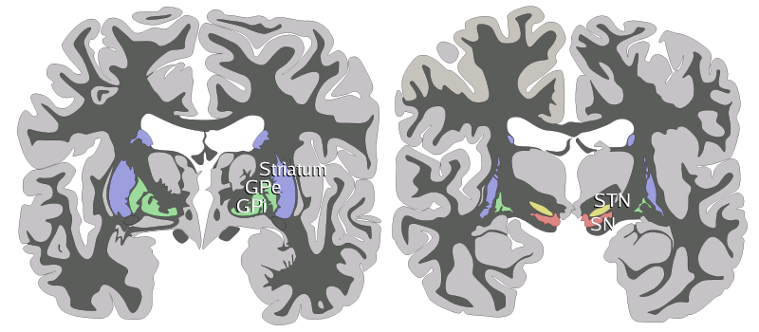
Subthalamic Nucleus - anatomy

Slide 10
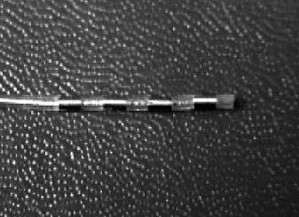
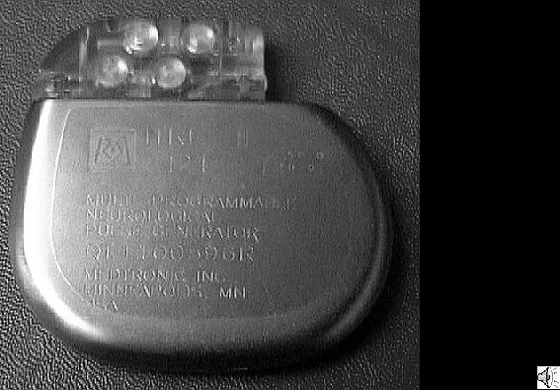
DBS – devices
Electrode Pulse generator (battery)

Slide 11
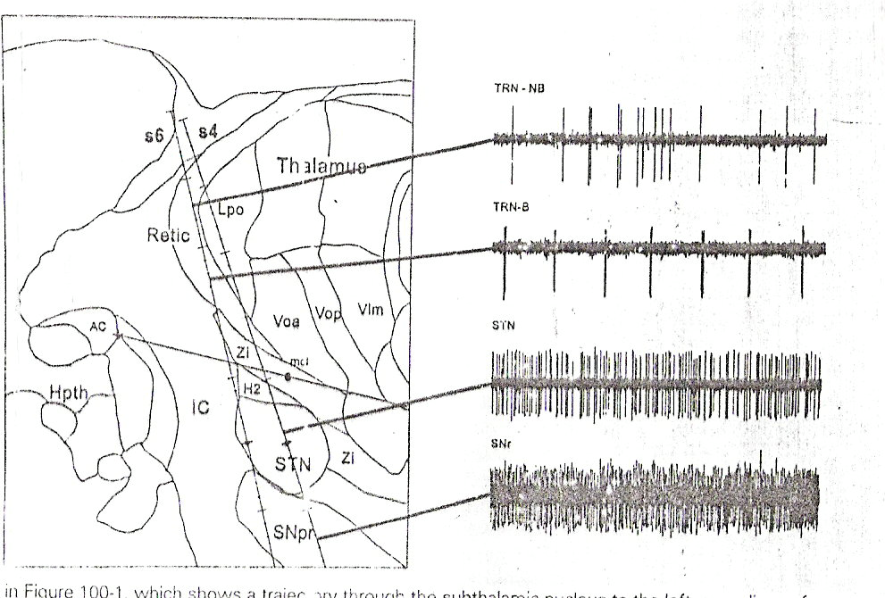
Microelectrode Recordings for STN

Slide 12
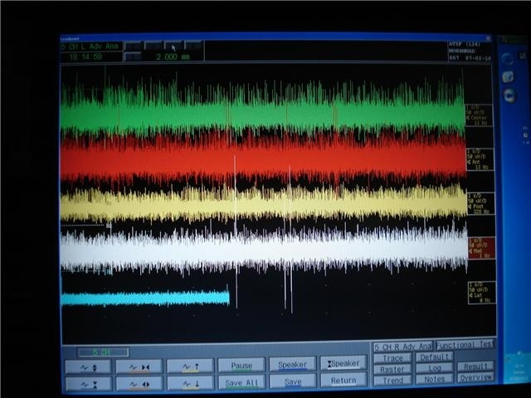
DBS: Microelectrode recordings

Slide 13
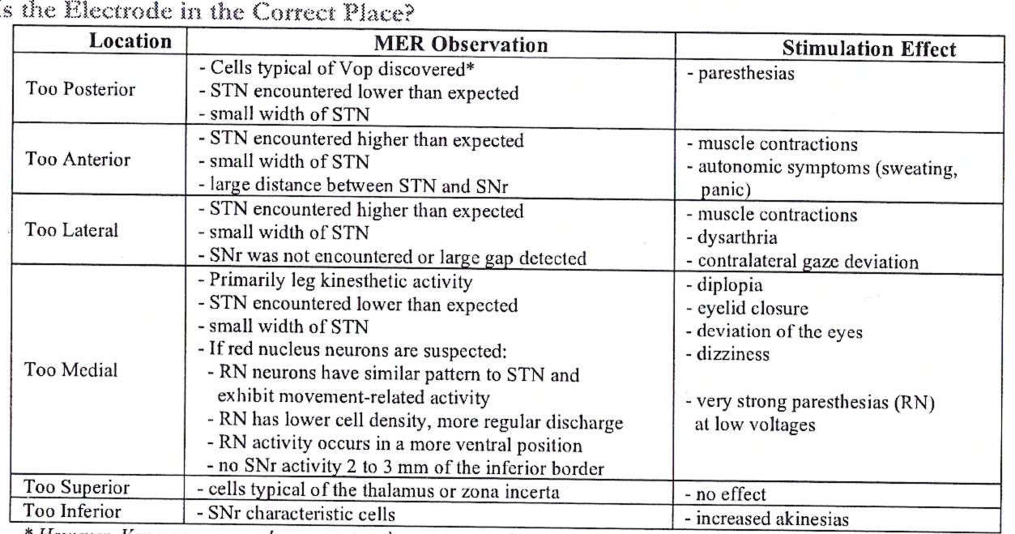
Is the electrode in the correct place ?

Slide 14
DBS for Parkinsonism
Symptoms which are improved by drug therapy are maximally improved with surgery
    Tremor 80%-100%
    Slowness (Bradykinesia) 50%-60%
    Stiffness (Rigidity) 50%-70%
    Gait, Freezing, and Balance 50%
    Dyskinesias & Dystonia (drug induced) 80%- 90%
    Motor fluctuations virtually eliminated
Independence and quality of life substantially improved.
Complications include haemorrhage (2-3%), Infection (1 -3%), mechanical hardware breakage (1-5%) and cognitive decline (2%).

Slide 15
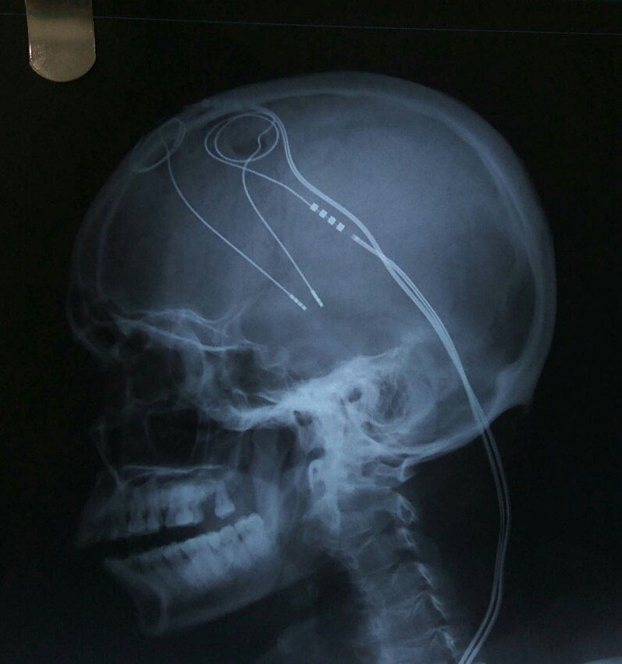
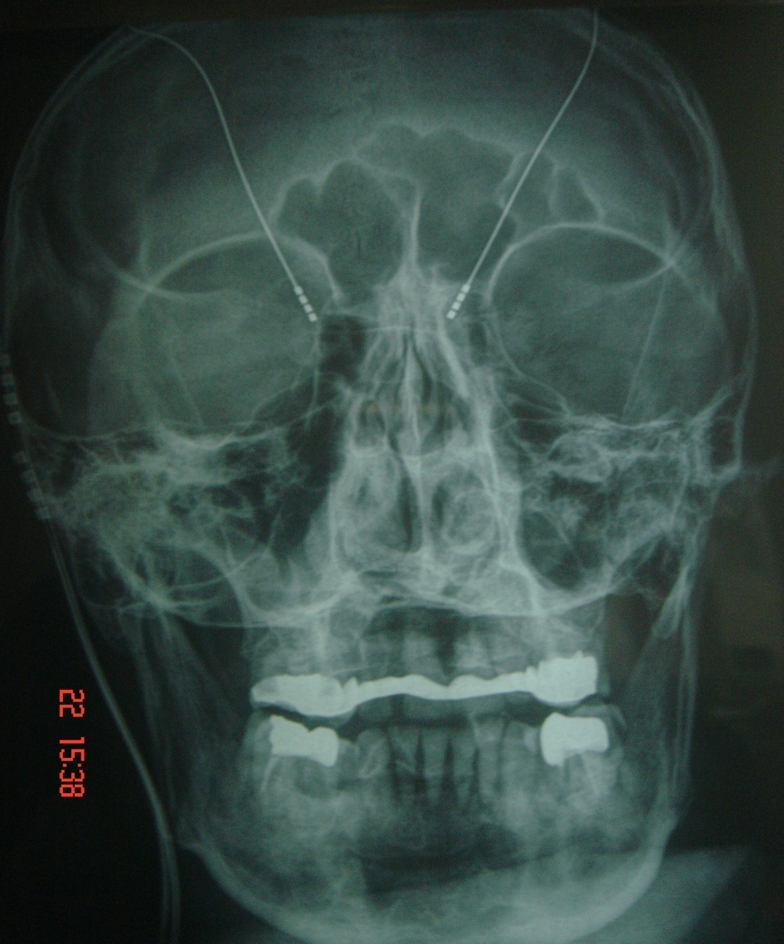
DBS for Parkinsonism – Post operative X rays.

Slide 16
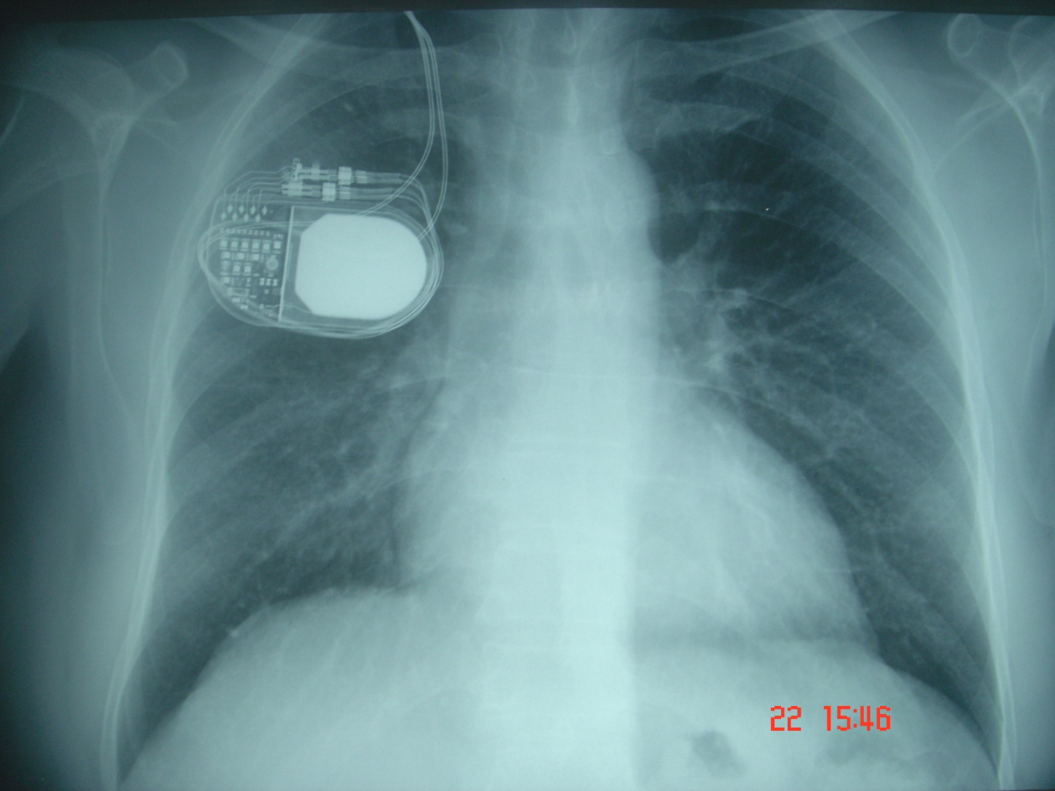
Chest X ray after surgery

Slide 17
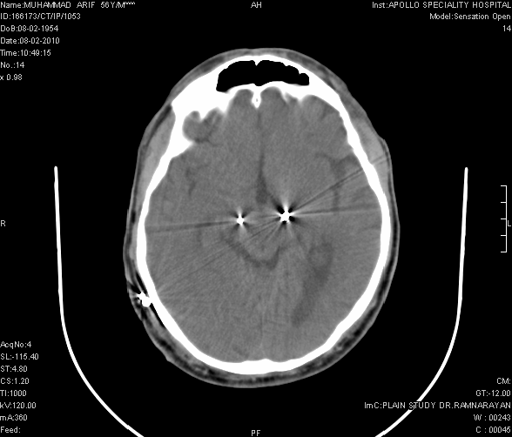
CT scan after surgery

Slide 18
Neurosurgery for psychiatry disorders
Previously various procedures like cingulotomy, various tractomies etc were done with highly variable and unpredictable results. So not used now.
Presently DBS useful for some conditions.
1. Intractable obsessive compulsive disease
2. Intractable depression
3. Tourettes’ syndrome.
4.Refractory addiction
5. Tardive dyskinesia
6. Aggressive behaviour in autism
7. Post Traumatic Stress disorders
8. Selected cases of schizophrenia (not perfected yet)

Slide 19
DBS for addiction
PET studies have shown that, when an individual takes a psychoactive substance, dopamine is released in the nucleus accumbens, which causes “the high”.
By an increased dopamine release in the nucleus accumbens, the inhibition of the output neurons is decreased, which causes activation of the reward system.
Case series and reports have shown DBS of nucleus accumbens causes reduction in alcohol, nicotine and heroin intake in human beings.
Studies in lab animals have also shown the same results.
DBS of nucleus accumbens has a good role in some psychiatric disorders like OCD, chronic depression etc.

Slide 20
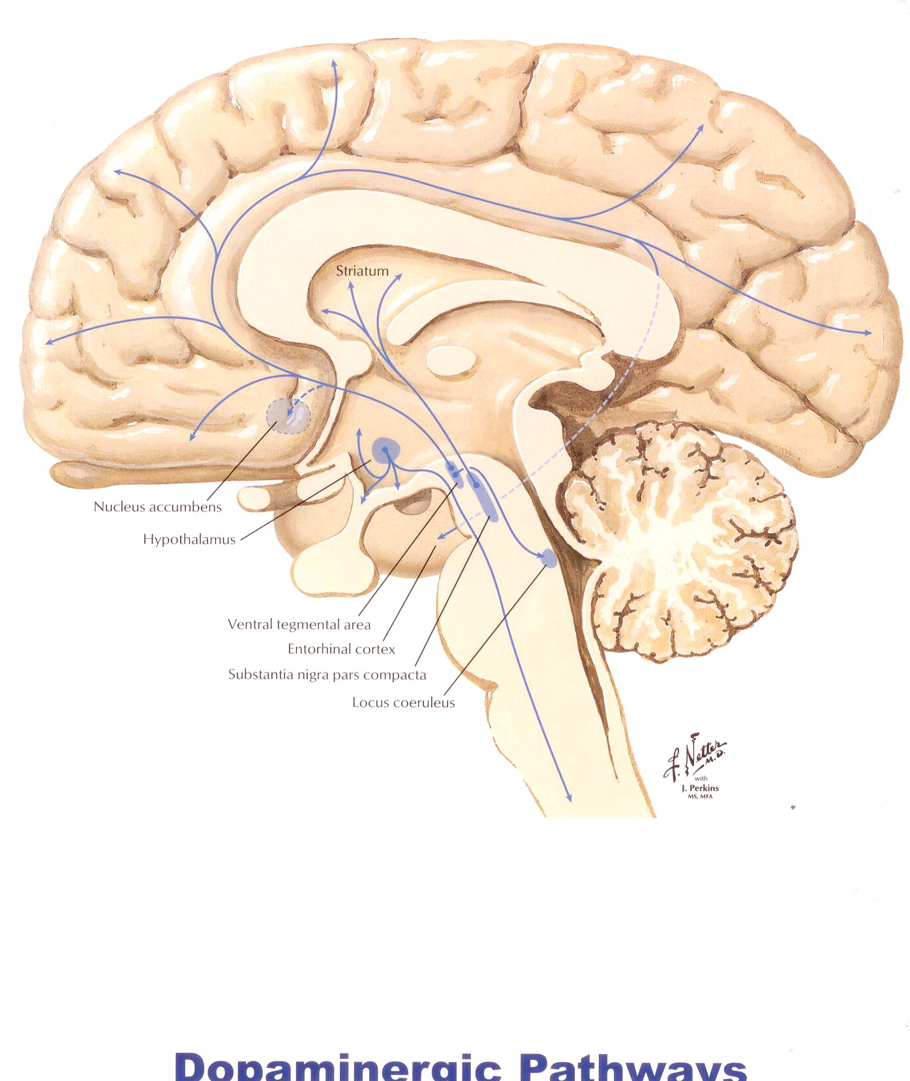
DBS for addiction

Slide 21
New DBS targets
Anterior limb of Internal Capsule – for resistant OCD.
Globus Pallidus (GPi) - target for dystonia.
Subthalamic Nucleus (STN) – for Parkinsonism.
Ventral Intermedius Nucleus (VIM) – essential tremor.
Anterior Nucleus of Thalamus –for refractory epilepsy
Nucleus Accumbens – for depression, obesity and addiction
Pedunculopontine Nucleus (PPN) – control posture and gait
Posterior Hypothalamus (PHypTh) -cluster headache
Subgenual Cortex(Brodmann area 25) – refractory depression
Ventromedial Nucleus of the Hypothalamus – obesity and anorexia nervosa.

Slide 22
Surgery for Epilepsy
Epilepsy is a condition characterized by the occurrence of seizures with or without alterations in consciousness resulting from abnormal electrical activity in the brain.
The main treatment of epilepsy is always medical.
In patients who are unresponsive to or intolerant of medical therapy, surgery becomes an option.
It is important to determine that all medical options have been exhausted prior to surgery.
Usual surgical procedures include
  resective (removing portions) surgery like lesionectomy, temporal lobectomy, corpus callosotomy, hemispherectomy.
  vagal nerve stimulation (VNS).
  DBS of anterior thalamus recently

Slide 23
DBS for epilepsy
VNS and Temporal lobectomy always not effective in epilepsy.
So alternatively DBS now being offered.
Target is anterior nucleus of thalamus (bilateral).
Indication: adjunctive treatment for partial-onset seizures in adults with medically refractory epilepsy.
Results: 40.4% reduction in seizures (DBS) compared with 14.5% in a control group. Two years after implantation of the DBS device, seizures were reduced by a median 56% compared with baseline, and 14 patients (12.7%) became seizure free for at least 6 months.
Approved in Europe but not FDA now.

Slide 24
Surgery for Chronic pain
Pain : very common symptom
Two types: acute and chronic
Acute pain :
    considered protective & of limited duration.
    usually seen in an acute setting & associated with external injuries, burns, surgery etc.
    well controlled by pharmacological measures.
Chronic pain
    is longer duration
    Persists long after initial injury.
    requires pharmacological, psychological and even surgical measures.

Slide 25
Chronic Pain
Chronic pain: When pain persists/recurs > 6 m.
Such pain no longer serves a useful purpose but can cause severe psychosocial and financial effects.
Normal living becomes severely restricted or even impossible and will lead to much suffering on the part of patient & family.
Patients go from doctor to doctor but never get cured.
Most of these medicines can affect the heart and kidneys if used repeatedly.
The US Congress had declared 2000 – 2010 “ Decade of pain treatment and research.
Unfortunately in our country pain is not being given the importance it deserves.

Slide 26
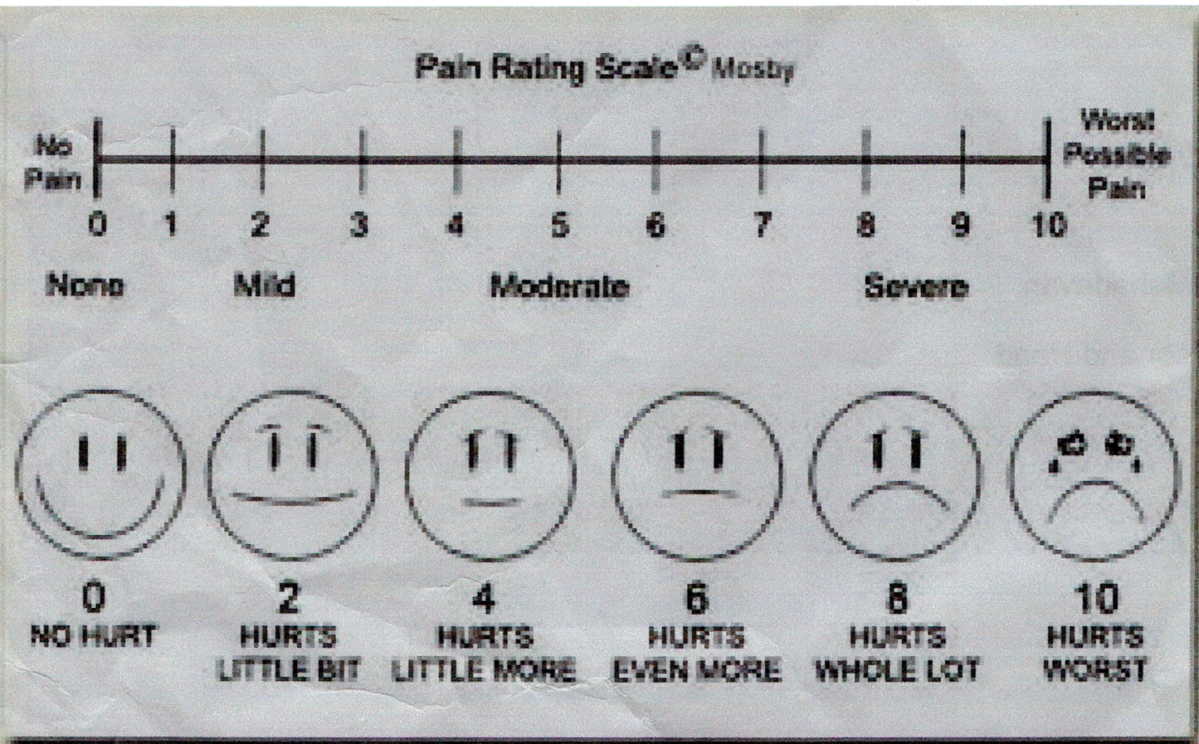
Visual assessment of pain

Slide 27
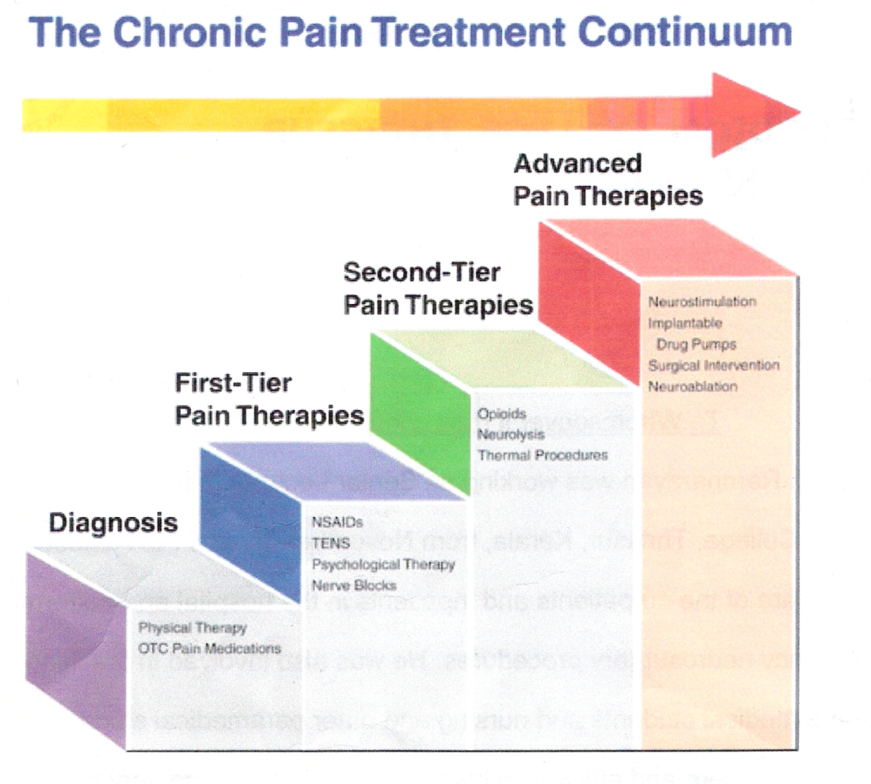
WHO Analgesic Ladder

Slide 28
Intrathecal drug delivery
Intrathecal drug delivery systems can deliver drugs like morphine and baclofen directly into the intrathecal space which can act directly on receptors in spinal cord.
Dose of drug required is about 1/200th of oral dose ( morphine)
Side effects like constipation/drowsiness does not occur
No systemic absorption so no problem with tolerance and addiction liability.
Many studies - effective in reducing pain in more than 80% of patients and the safety profile of this method.
Intrathecal baclofen very effective in spasticity of various aetiology and also in flexor spasms pain.
Many recent indications like TRH in chronic depression is gaining importance.

Slide 29
Intrathecal Drug Delivery
Intrathecal morphine indicated:
    severe cancer pain
    failed back surgery syndrome,
    osteoporotic pain,
    complex regional pain syndromes like brachial plexus injuries, painful neuropathies etc.
Intrathecal baclofen indicated in spasticity due to
a) All types of spasticity as in
cerebral palsy
multiple sclerosis
stroke
traumatic paraplegics etc.
b) Patients in persistent vegetative state.
c) Cases of spino-cerebellar degeneration
d) Cerebellar type of MS

Slide 30
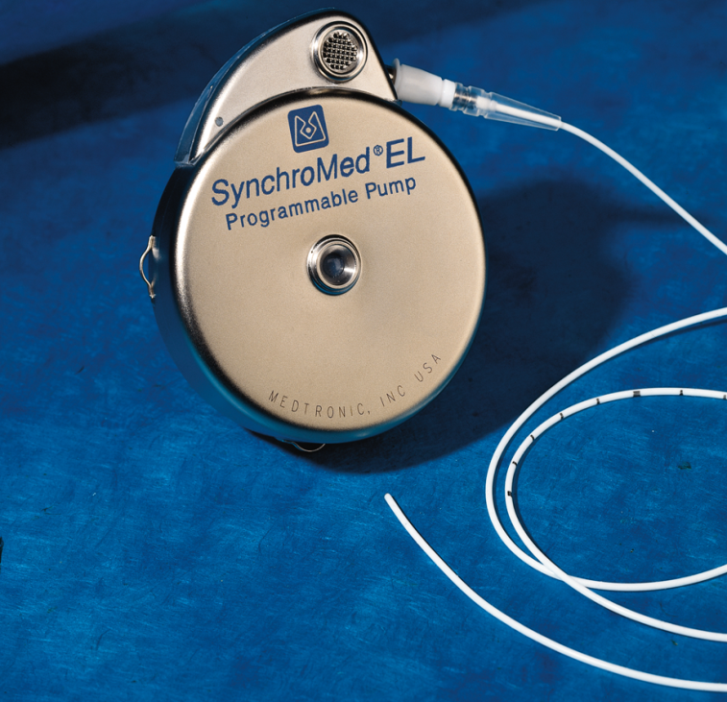
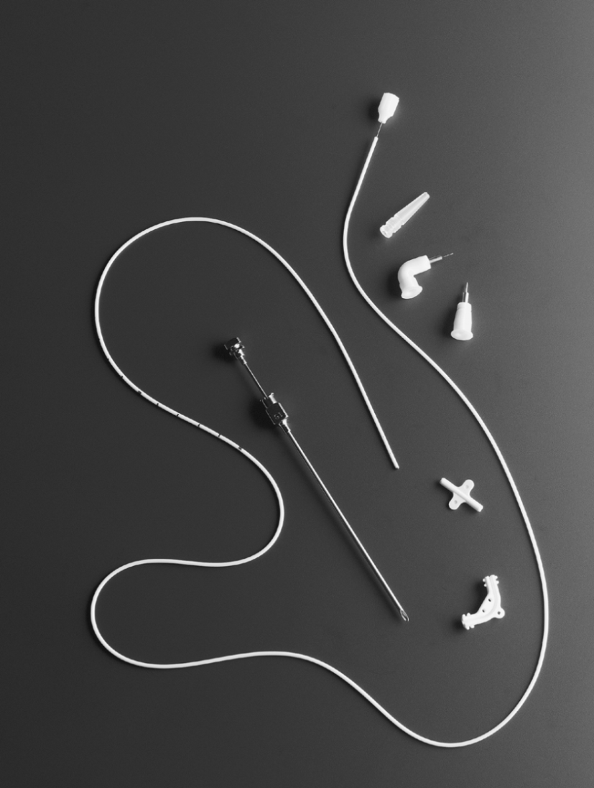
Intrathecal Drug Delivery

Slide 31
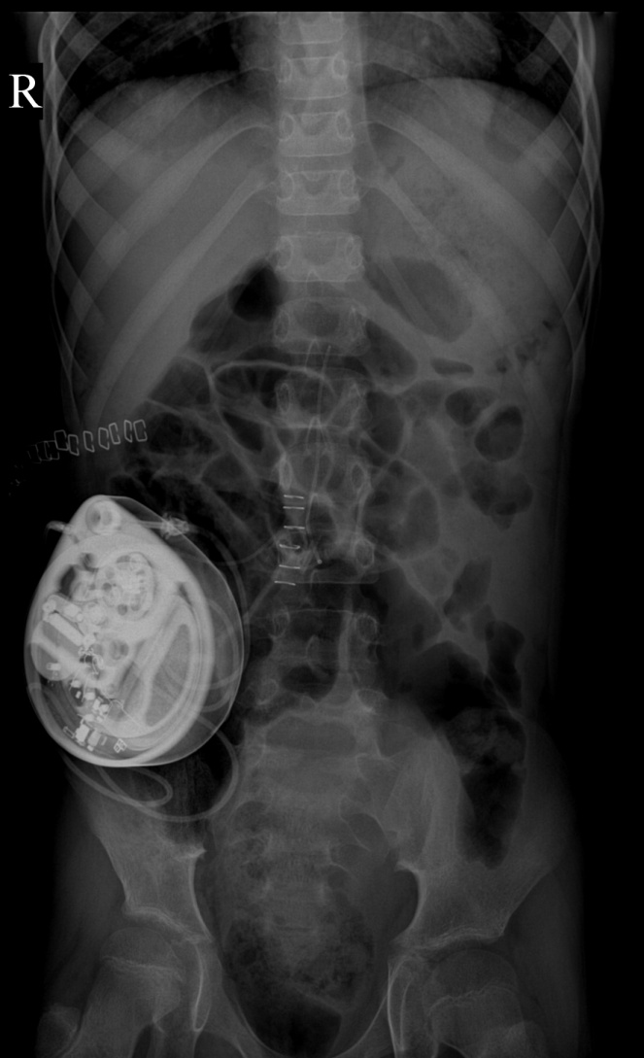
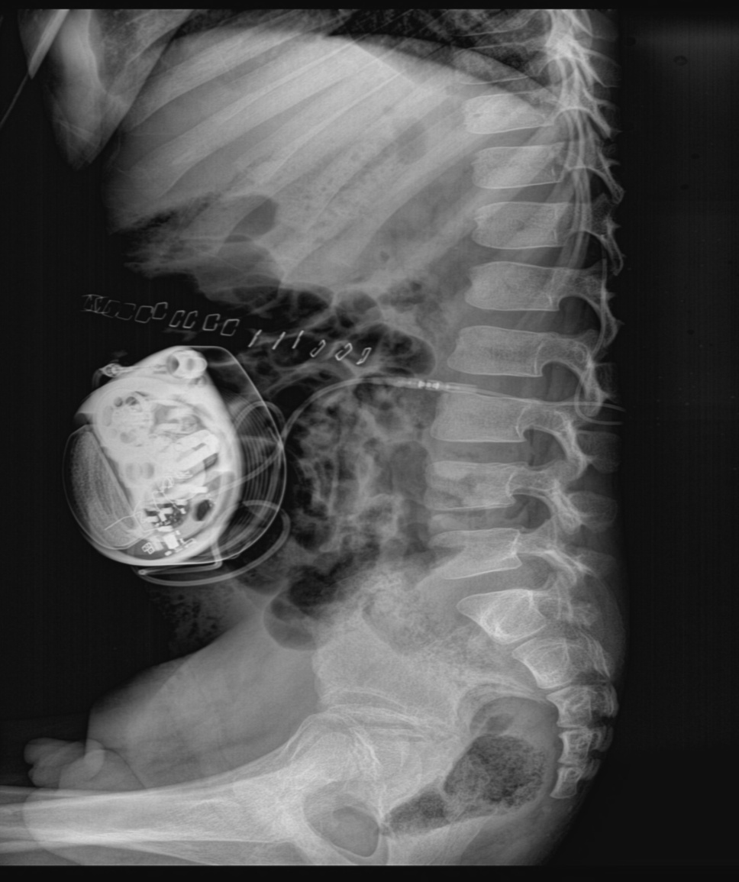
Intrathecal morphine/baclofen pump (Post op X rays)

Slide 32
Spinal cord stimulator
Indicated in
  failed back surgery syndrome,
  intractable diabetic neuropathy pain,
  refractory angina/ cardiac failure
  complex regional pain syndromes and
  brachial plexus injuries pain,
  pain due to peripheral vascular disease,
  radiculopathies like pain in the arm,
  phantom limb pain (after amputation),
  neuralgias like trigeminal neuropathies etc .
Method - introduce stimulating electrodes in dorsal extradural space.
Studies have shown this is very effective in 60 – 80% of pts.

Slide 33
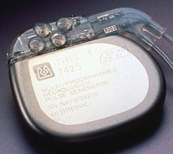
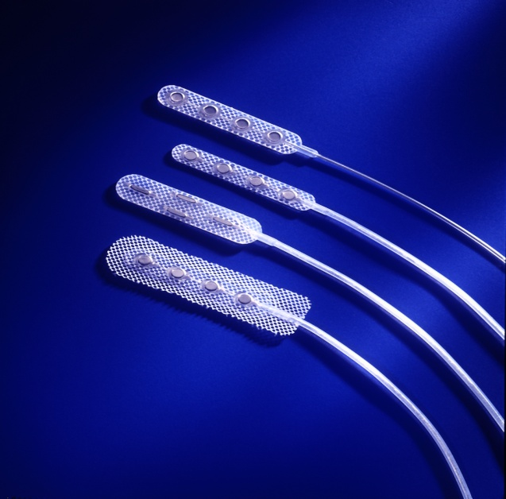
Spinal cord stimulator

Slide 34
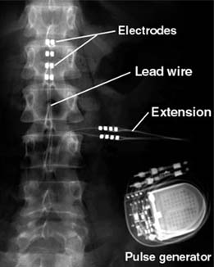
Spinal cord stimulator at T8 level with IPG

Slide 35
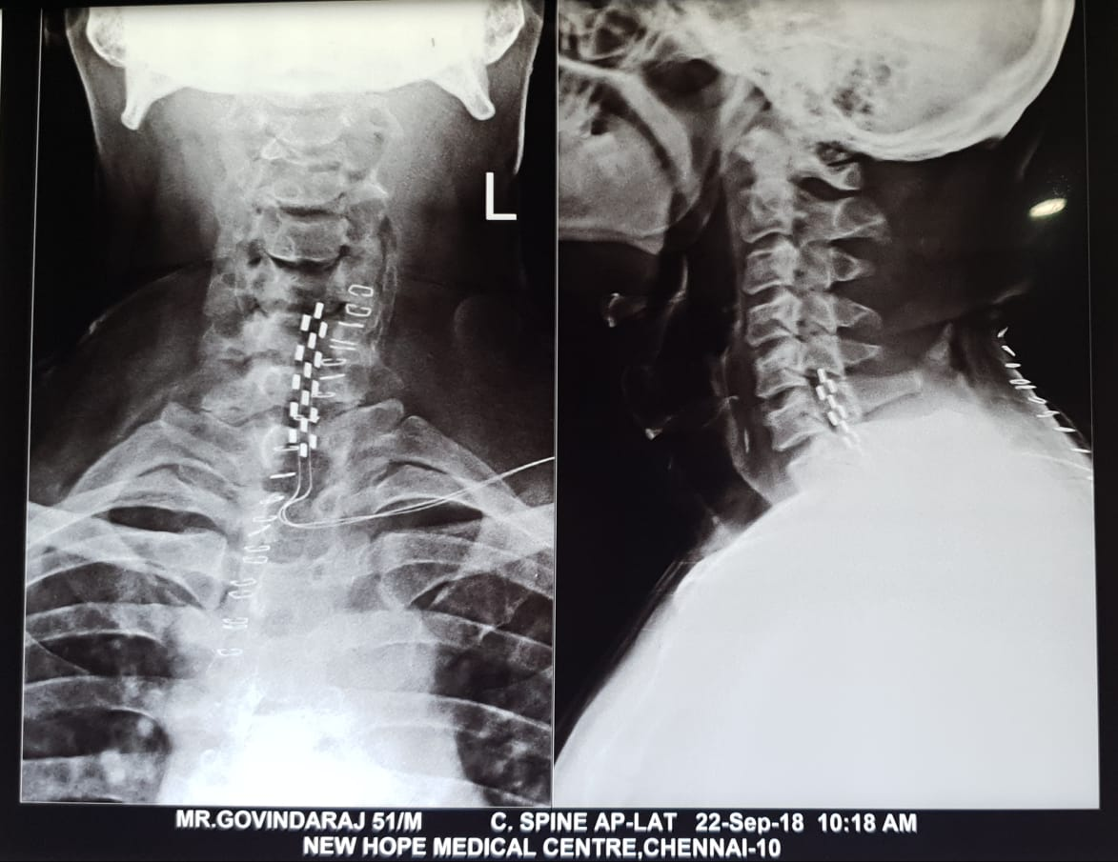
Spinal cord stimulator at C6 level for brachial pleus injury pain

Slide 36
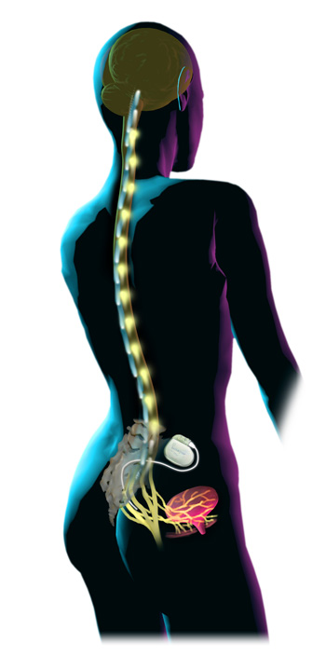
What is Sacral Nerve Stimulation
Sacral Nerve Stimulation (SNS) is stimulation of the sacral nerves to modulate the reflexes that influence the bladder, sphincter, and pelvic floor.
SNS utilizes mild electrical pulses to improve or restore normal voiding function.
Notes:
To understand InterStim Therapy, it’s important to understand normal micturition and the neuroanatomy of the lower urinary tract.

Slide 37
Indications for sacral nerve stimulation
The best indication is in patients who have failed or could not tolerate more conservative treatments:
a) Urinary incontinence
b) Urinary retention ( non-Obstructive)
c) Faecal incontinence
d) constipation
e) some cases of irritable bowel syndrome
f) Severe pelvic pain in women
Candidates are decided by a trial procedure and also by comparing voiding diaries before and after the trial procedure. An improvement of more than 50% is taken as an indication for surgery.
Notes:
For urge incontinence and symptoms of urgency-frequency where patients failed or did not tolerate standard treatments, including:
Pharmacologic Therapy
Behavioral therapies such as biofeedback, timed voids, pelvic muscle exercises
For non-obstructive retention where patients failed or did not tolerate standard treatments, including:
Pharmacologic Therapy
Interventional treatments, such as catheterization

Slide 38
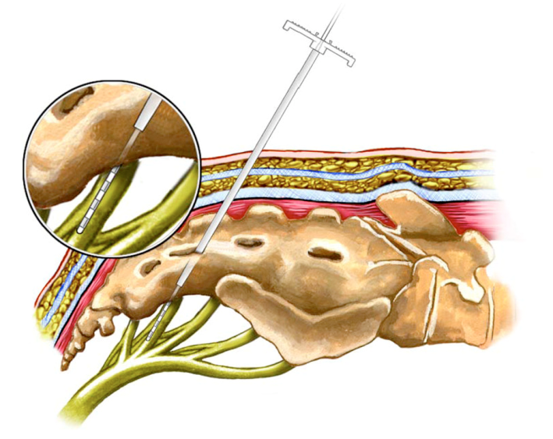
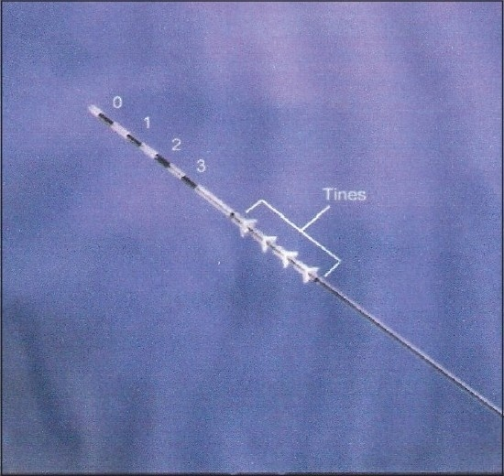
The SNS Electrode

Slide 39
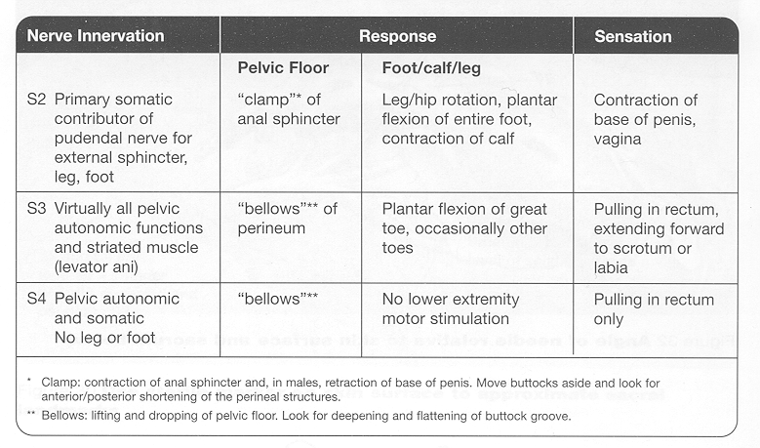
Look for Motor and Sensory Responses
Notes:
[Review sensations and motor responses that indicate S3 lead placement. Discuss how stimulation feels to the patient.]
The goal of lead placement:
If the lead is precisely placed, a response should be observed intraoperatively at 1.0–2.0 V on the maximum number of electrodes.
If motor responses are only observed intraoperatively at >5.0 V, the lead should be repositioned.

Slide 40
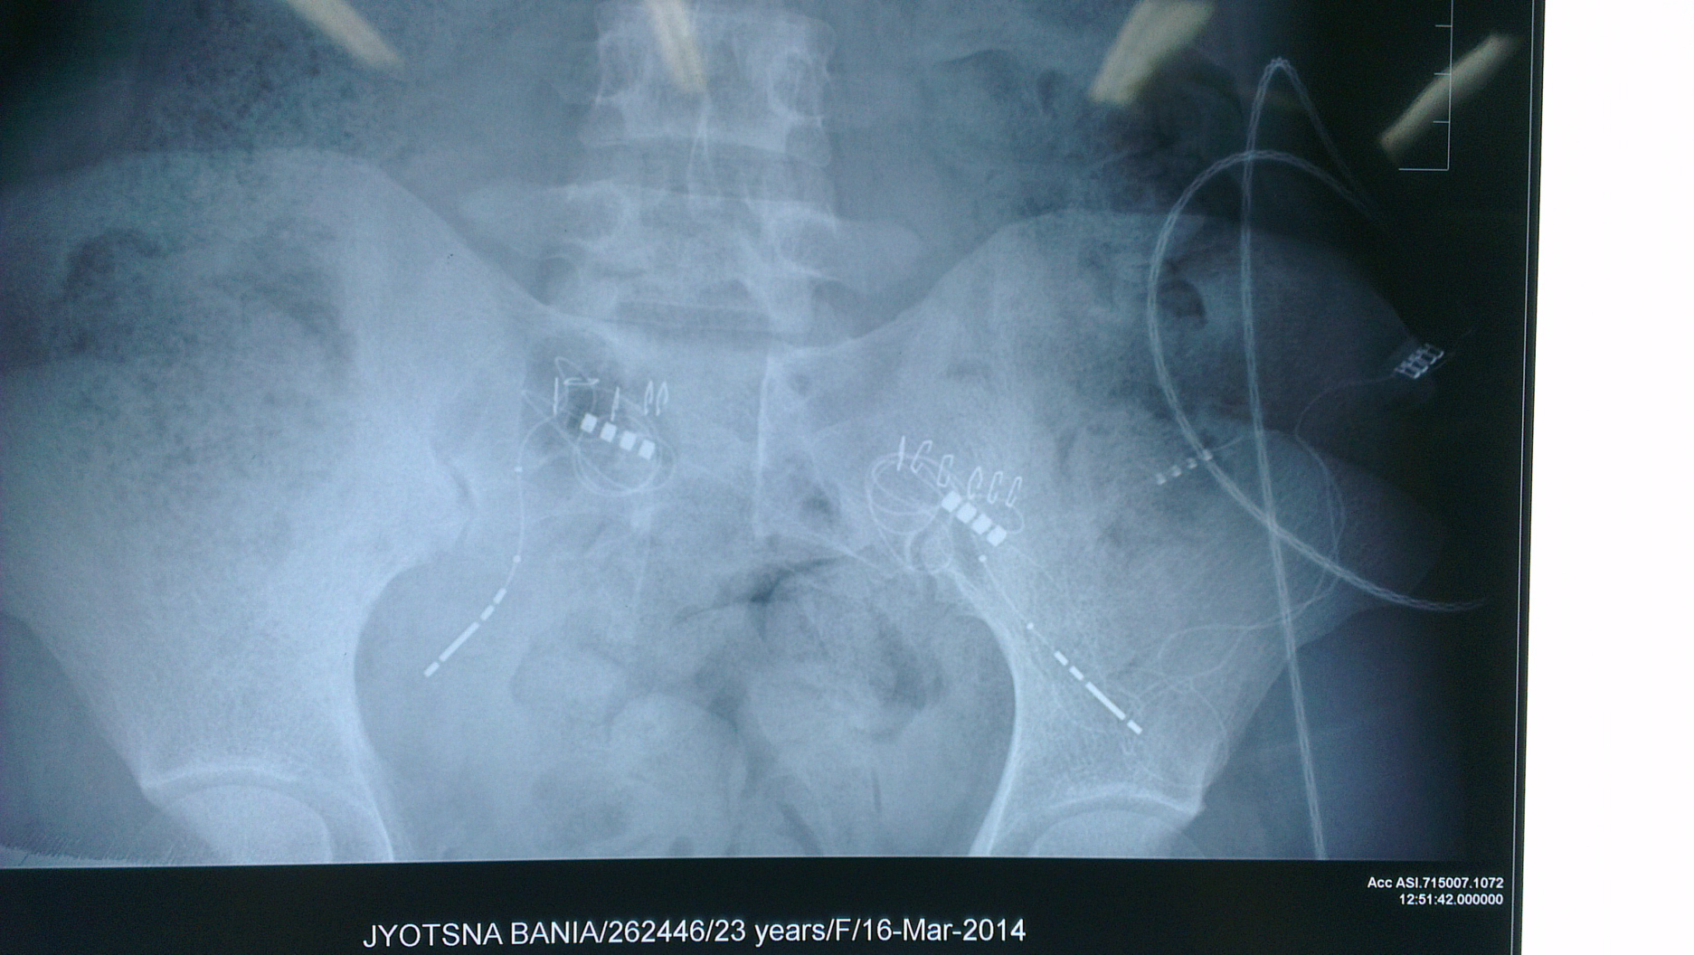
Post op X rays in SNS

Slide 41
Vagal Nerve Stimulation
Vagus nerve stimulation involves the use of a device to stimulate the vagus nerve with electrical impulses. An implantable vagus nerve stimulator is currently FDA-approved to treat epilepsy and depression. The device sends electrical signals along the left vagus nerve to the brainstem, which then sends signals to certain areas of the brain. The right vagus nerve isn't used because it's more likely to carry fibers that supply nerves to the heart.
Right cervical VNS is effective for treating heart failure in preclinical studies but not approved yet.
The main indications remain
1. Uncontrolled seizures especially focal ones
2. Treatment resistant depression

Slide 42
Vagal Nerve Stimulation
Not all patients with medically refractory epilepsy are candidates for resective surgery. Resective surgery is not always an option for medically refractory seizures.
Vagus nerve stimulation (VNS) is an adjunctive treatment for certain types of intractable epilepsy and major depression.
Vagus nerve stimulation (VNS) is designed to prevent seizures by sending regular, mild pulses of electrical energy to the brain via the vagus nerve.
Indications include patients who have failed surgery before, require extratemporal surgery in eloquent area or corpus callosotomy or patients choice.

Slide 43
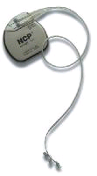
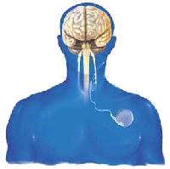
Vagal Nerve Stimulation

Slide 44
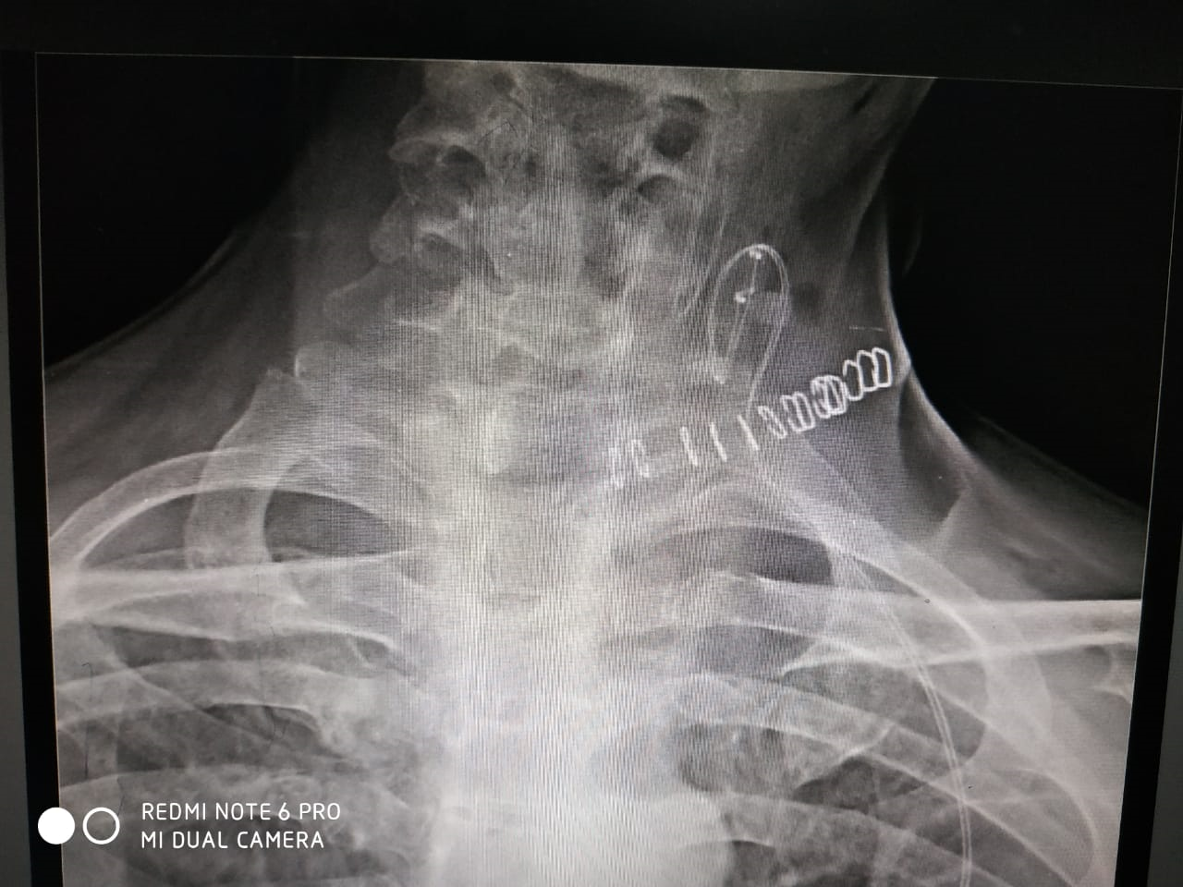
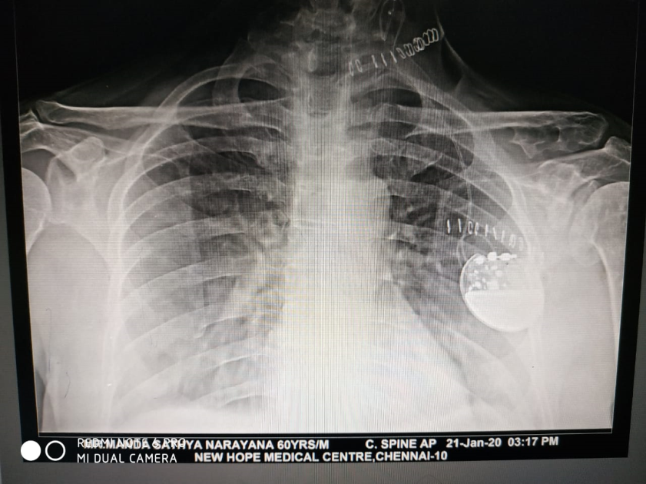
Vagal narve stimulator post operative X ray

Slide 45
THANK YOU & BEST WISHES
Dr. R. Ramnarayan
+919003022445 / +918072498051
Email: r.ramnarayan65@gmail.com r.ramnarayan@rediffmail.com www. lakshmineuroclinic.com

